Slide 1
Project 1.
Automatic Controlled
Metal Trebuchet
Team members: Yuchen Song, Wei Yan, Jingwen Deng, Minghui Yin, Junjie Li
Notes:
Enter speaker notes here.

Slide 2
Project 1
Content
Team Roles
Review of Design Problem
Benchmarking
Quantification
Initial design
Project Schedule
Q&A
Notes:
Enter speaker notes here.

Slide 3
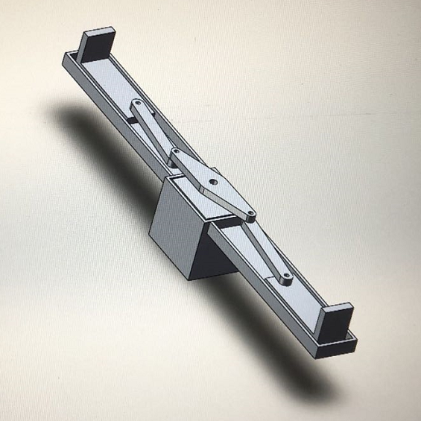



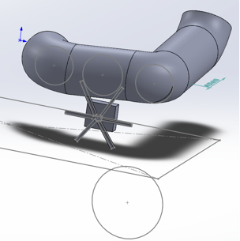
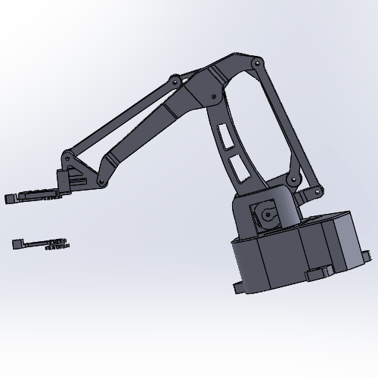
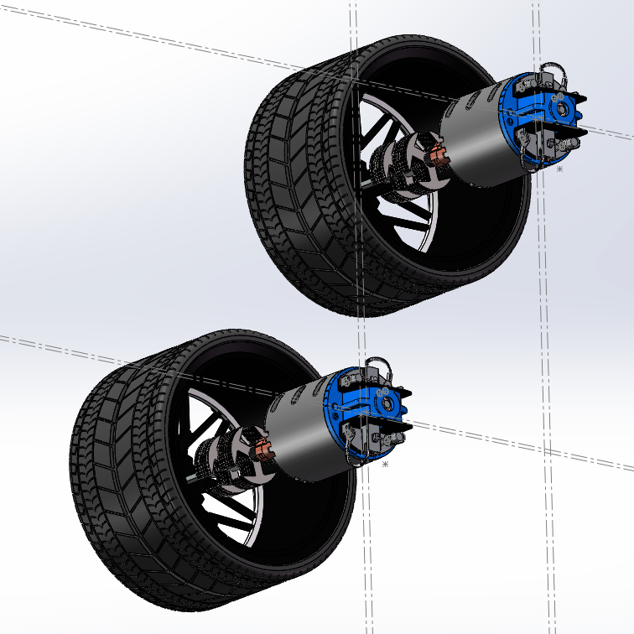
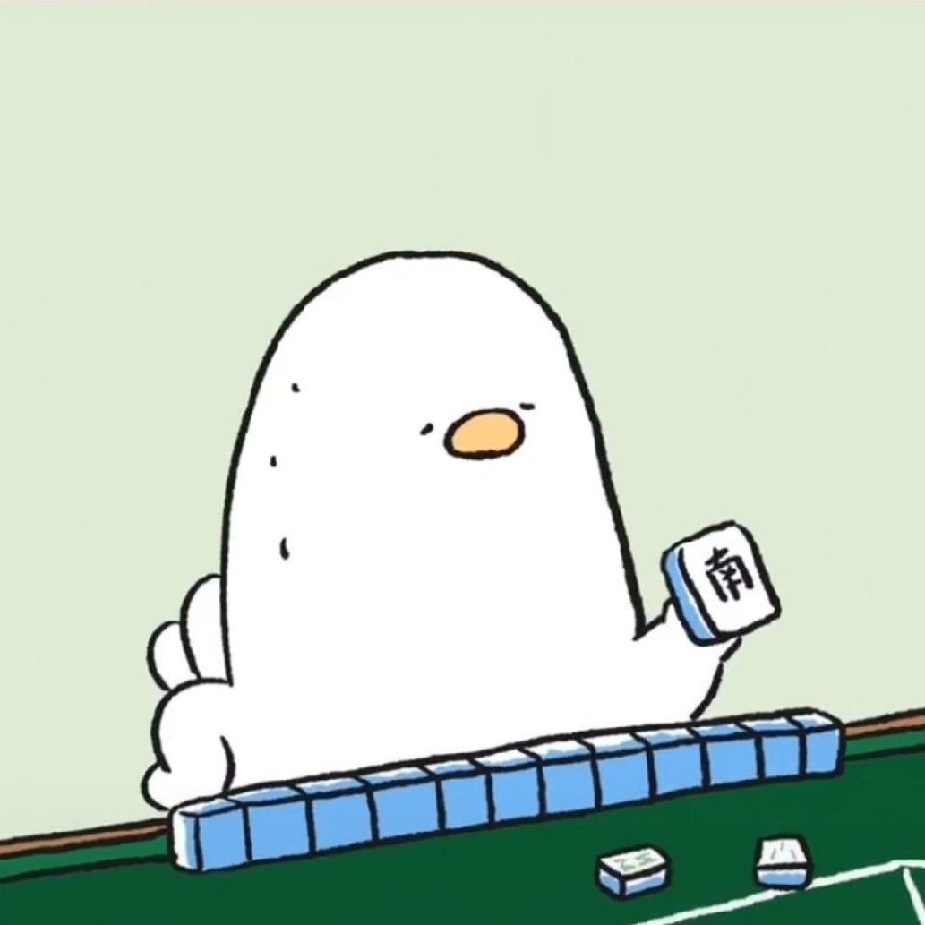

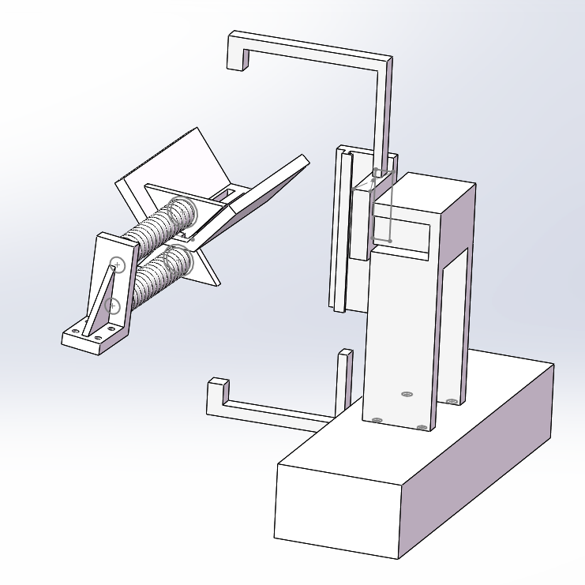
Project 1
Team Roles
Yuchen Song
(Shifting module)
Junjie Li
(Ball clip)
Minghui Yin
(Robotic arm)
Wei Yan
(Catapulting module II)
Jingwen Deng
(Catapulting module I)
Notes:
Enter speaker notes here.

Slide 4
Project 1
Review of Design Problem
Size: 35cm×20cm×35cm
Movement: Powered by at least one DC motor
Control: Remote control
Time: 10 minutes
Requirement: At least one metal components
Functions:
shoot 3 kinds of balls into a basket
shoot at 3 places
reloading
Notes:
Enter speaker notes here.

Slide 5
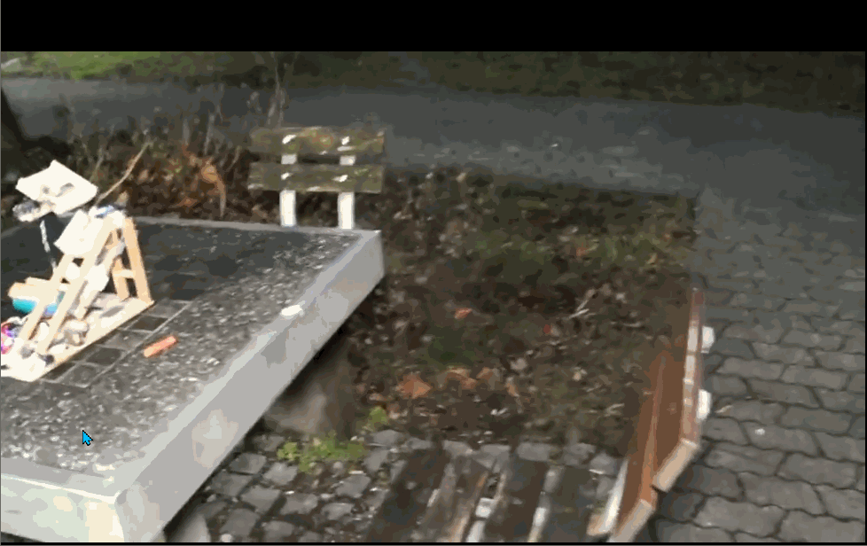
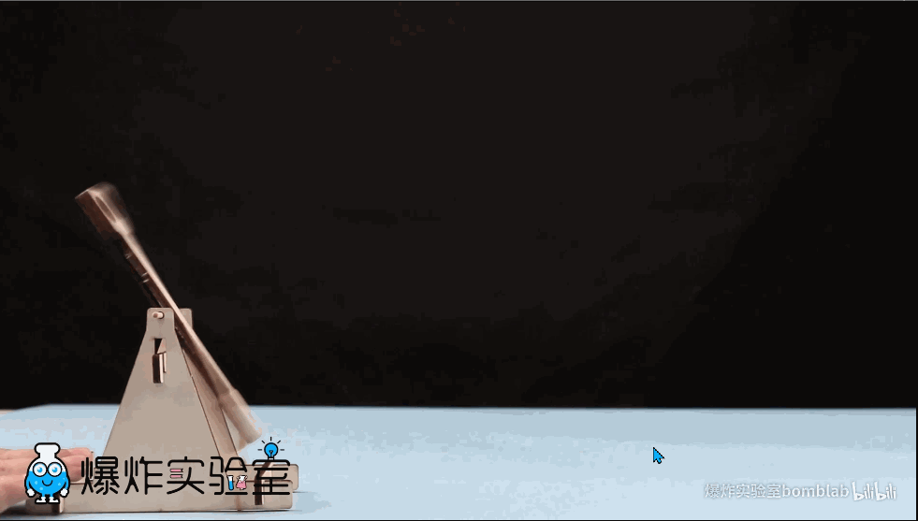
Project 1
Benchmarking
Features and functions that are important to the technical success of the product and the end user satisfaction?
Features and functions that differentiate the car from our competitors?
Which functions have the greatest potential for improvement?
Establish the quantified metrics.
Evaluate the product and its competing products using performance testing.
Generate a benchmarking conclusions.
Flexible movement
Accurate shooting
Stable remote control
Shooting device
Ball container
Robotic arm
https://www.youtube.com/watch?v=9faFlQ_P_Ro
https://www.bilibili.com/video/BV1Gs411G7hw
Notes:
Enter speaker notes here.

Slide 6
Project 1
Quantification
Customer Requirements | Importance Weight Factor
Size
Movement
Control
Reloading
Time limitation
Design of metal components
Accuracy of shooting
Notes:
Enter speaker notes here.

Slide 7
Project 1
Quantification
Engineering Characteristics
↓ | ↑ | n/a | n/a | ↑ | ↑ | ↑ | ↑
cm | n/a | n/a | Hz | m | 1 | m | n/a
External dimension | Flexibility of wheels | DOF of wheels | Frequency of remote communication | Range of remote control | Capacity of balls | Shooting range of Catapult | Cooperation of different components
Notes:
Enter speaker notes here.

Slide 8
Project 1
Quantification
Engineering Characteristics
↓ | ↑ | n/a | n/a | ↑ | ↑ | ↑ | ↑
cm | n/a | n/a | Hz | m | 1 | m | n/a
External dimension | Flexibility of wheels | DOF of wheels | Frequency of remote communication | Range of remote control | Capacity of balls | Shooting range of Catapult | Cooperation of different components
Improvement Direction
Units
Customer Requirements | Importance Weight Factor
Size
Movement
Control
Reloading
Time limitation
Design of metal components
Accuracy of shooting
Notes:
Enter speaker notes here.

Slide 9
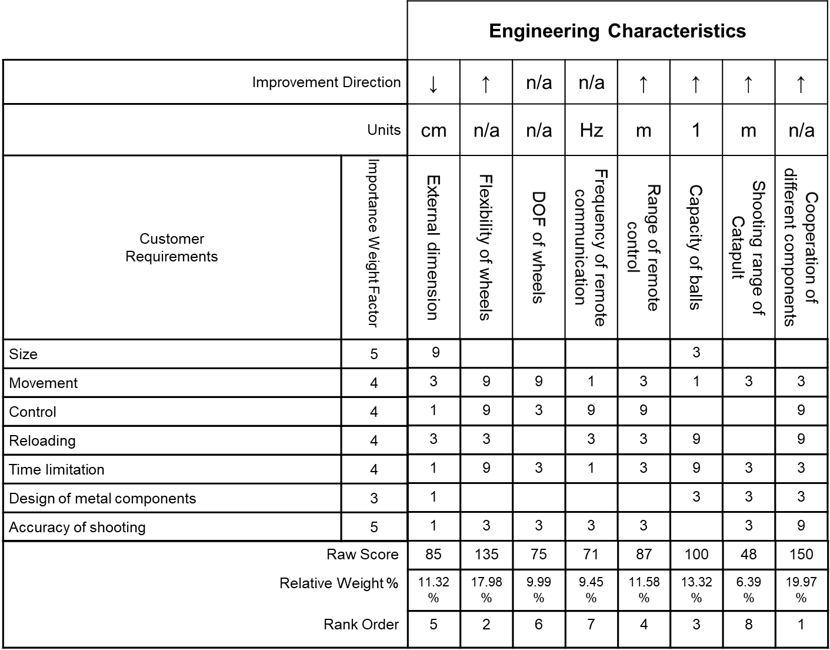
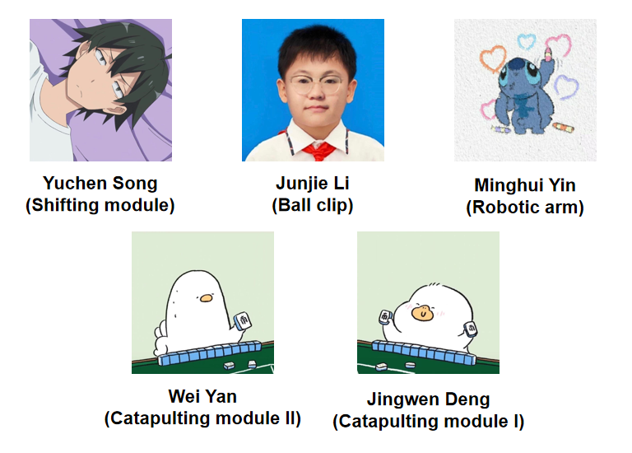
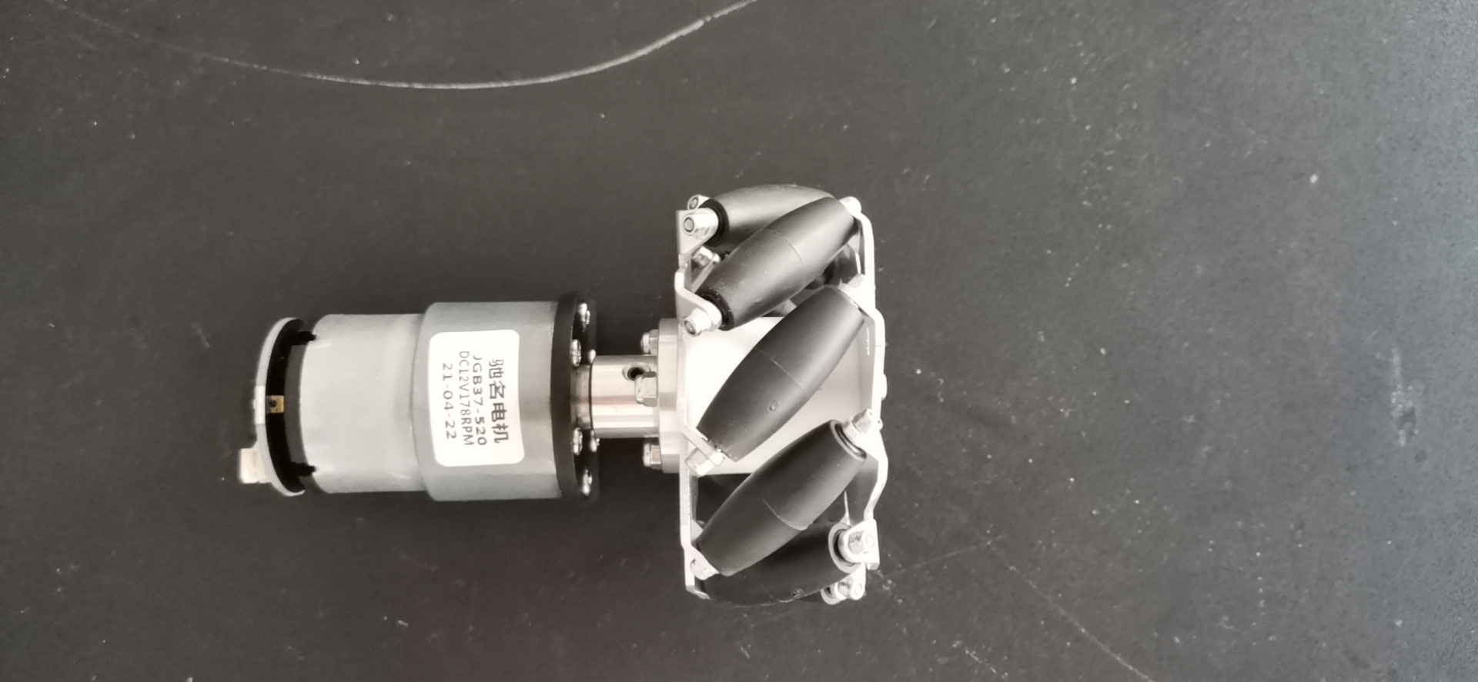
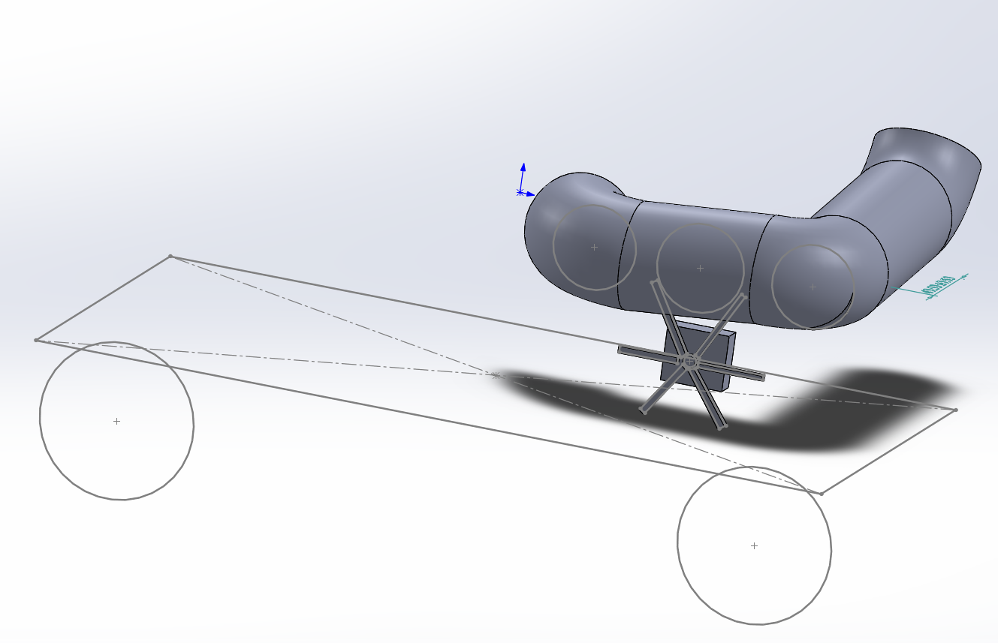
Project 1
Quantification
Notes:
Enter speaker notes here.

Slide 10
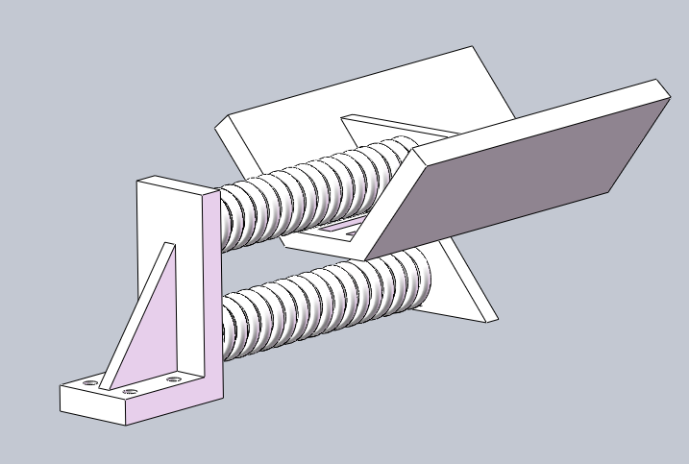
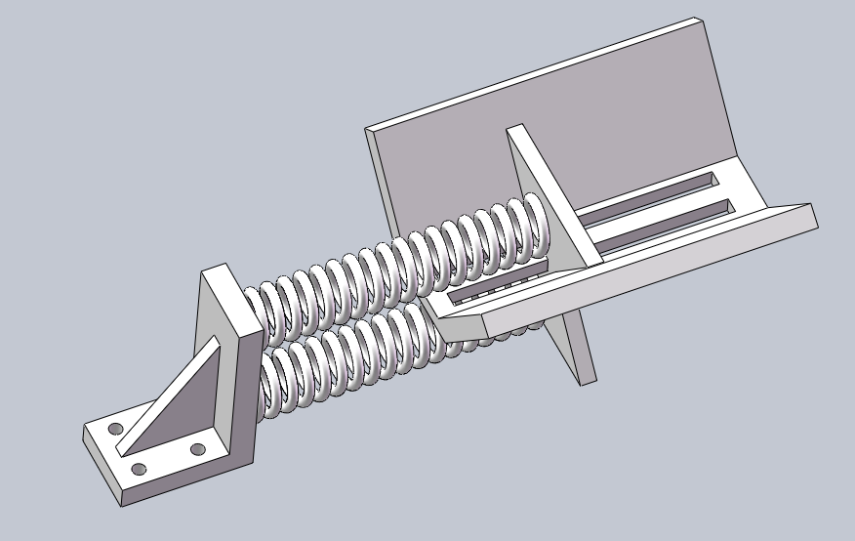
Project 1
Initial design - Catapulting Module v1
baffle
Based on spring
2 springs to keep balance
Adapt to different sizes of balls
Limit ejection direction
Notes:
Our first plan is to make use of the springs to provide motivation. As shown in the figures, this device mainly consists of three parts: springs, baffle and the track.
Before shooting, the ball will be placed on the track. Then, the baffle will be pulled back. Once the baffle is released, the ball will be shooted along the track.
In order to limit the ejection direction of the ball. We designe a V-Shape track. Its advantage is that it can adapt to different sizes of ball.

Slide 11
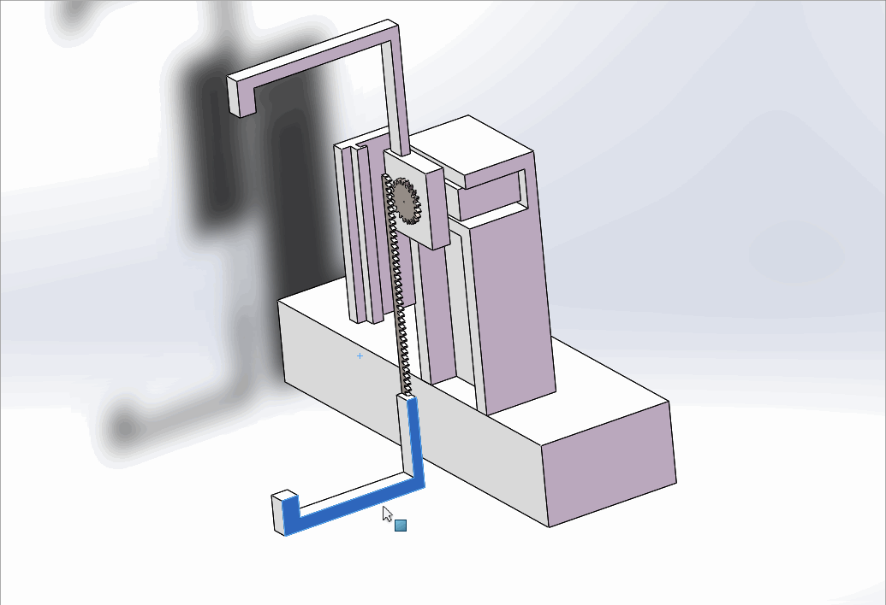
Project 1
Initial design - Catapulting Module v1
Close the claw
Pull the baffle back
Open the claw
The ball is pushed off
baffle
Notes:
In order to pull the baffle back, we designed a claw controlled by servo motor.
With the servo motor rotates, the gear will drive the rack, controlling the claw moving up and down.
When the claw close, it can clamp the baffle, foring the baffle moving back and compressing the spring.
When the claw open, the force applied to the baffle disappears and the spring will return to its original length. The ball will be pushed off.

Slide 12
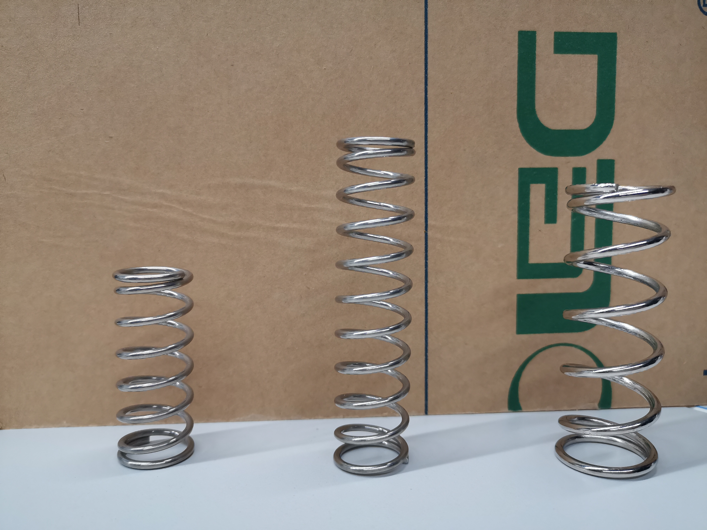
Project 1
Initial design - Catapulting Module v1
Limitations
Cannot provide enough force to compress the spring
The spring returns to its original length slowly
baffle

Slide 13
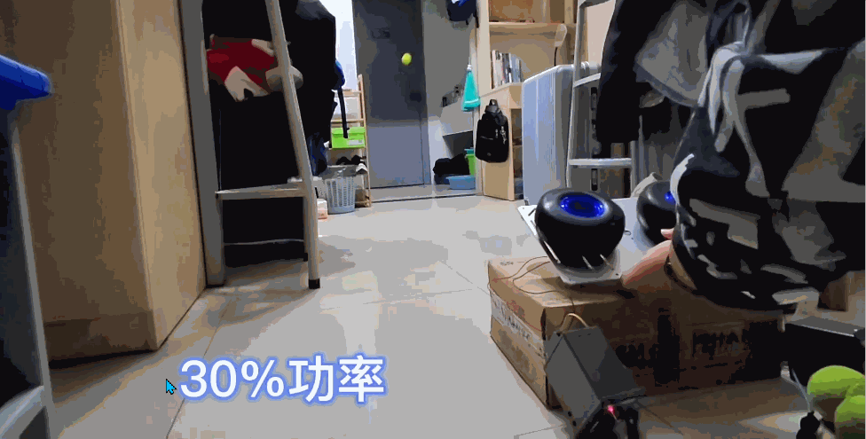
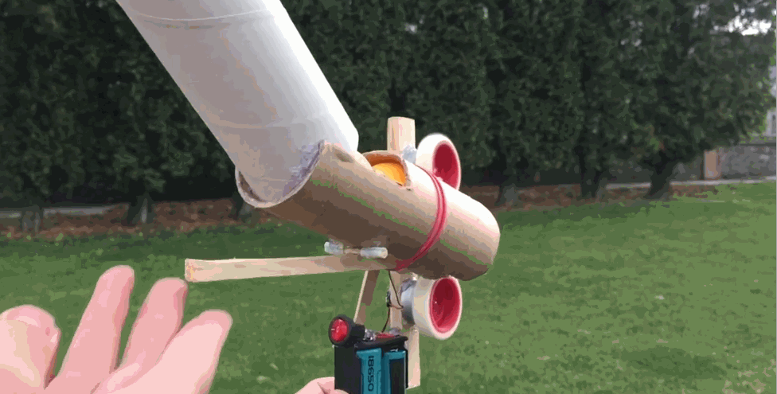
Project 1
Initial design - Catapulting Module v2
baffle
However, for the applications of our project, we especially need the following functions and features:
Controllable spacing of frictional wheels
Powerful DC motors
Thick and rough lateral surface of tires
https://www.bilibili.com/video/BV1LN411Q7y8
https://www.bilibili.com/video/BV1Ex411E7CV

Slide 14
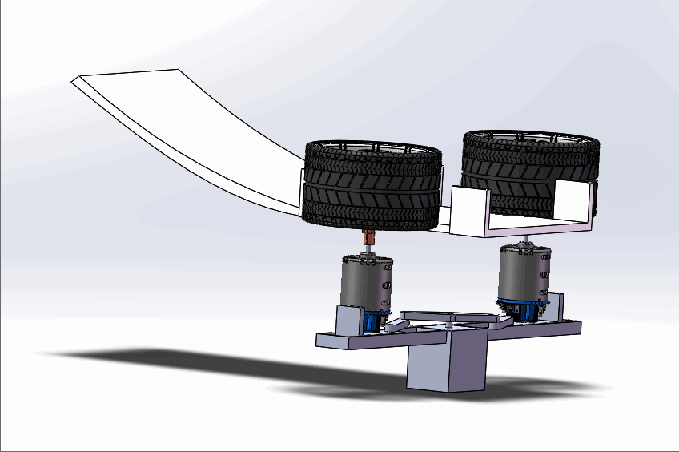
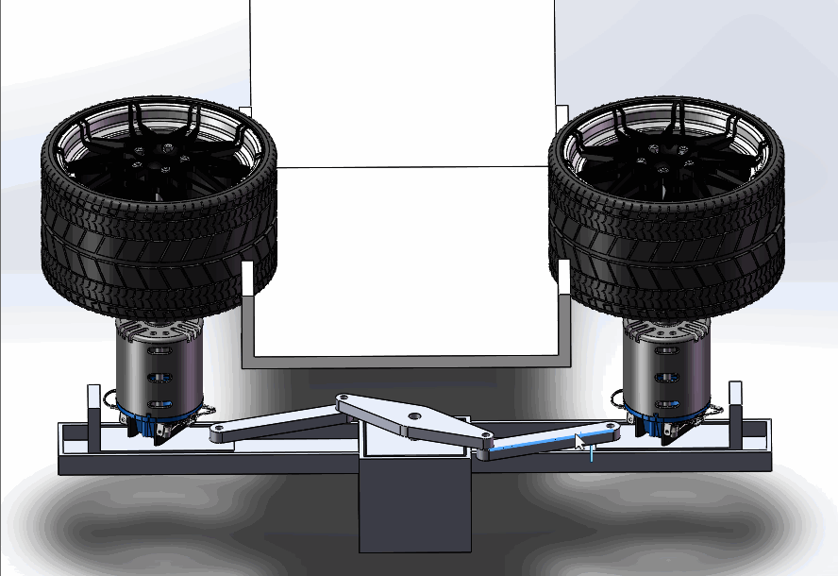
Project 1
Initial design - Catapulting Module v2
Transmission rod structure driven by servo motor
High power DC motors placed on a horizontal level
Rough and large tires
Notes:
To adapt to different sizes of balls, we design a rod-transmission structure to control the spacing.
By remotely sending commands to the servo motor using Bluetooth, this device is able to shoot three different types of balls. The rotation of the wheels should be powerful enough to launch the balls.

Slide 15
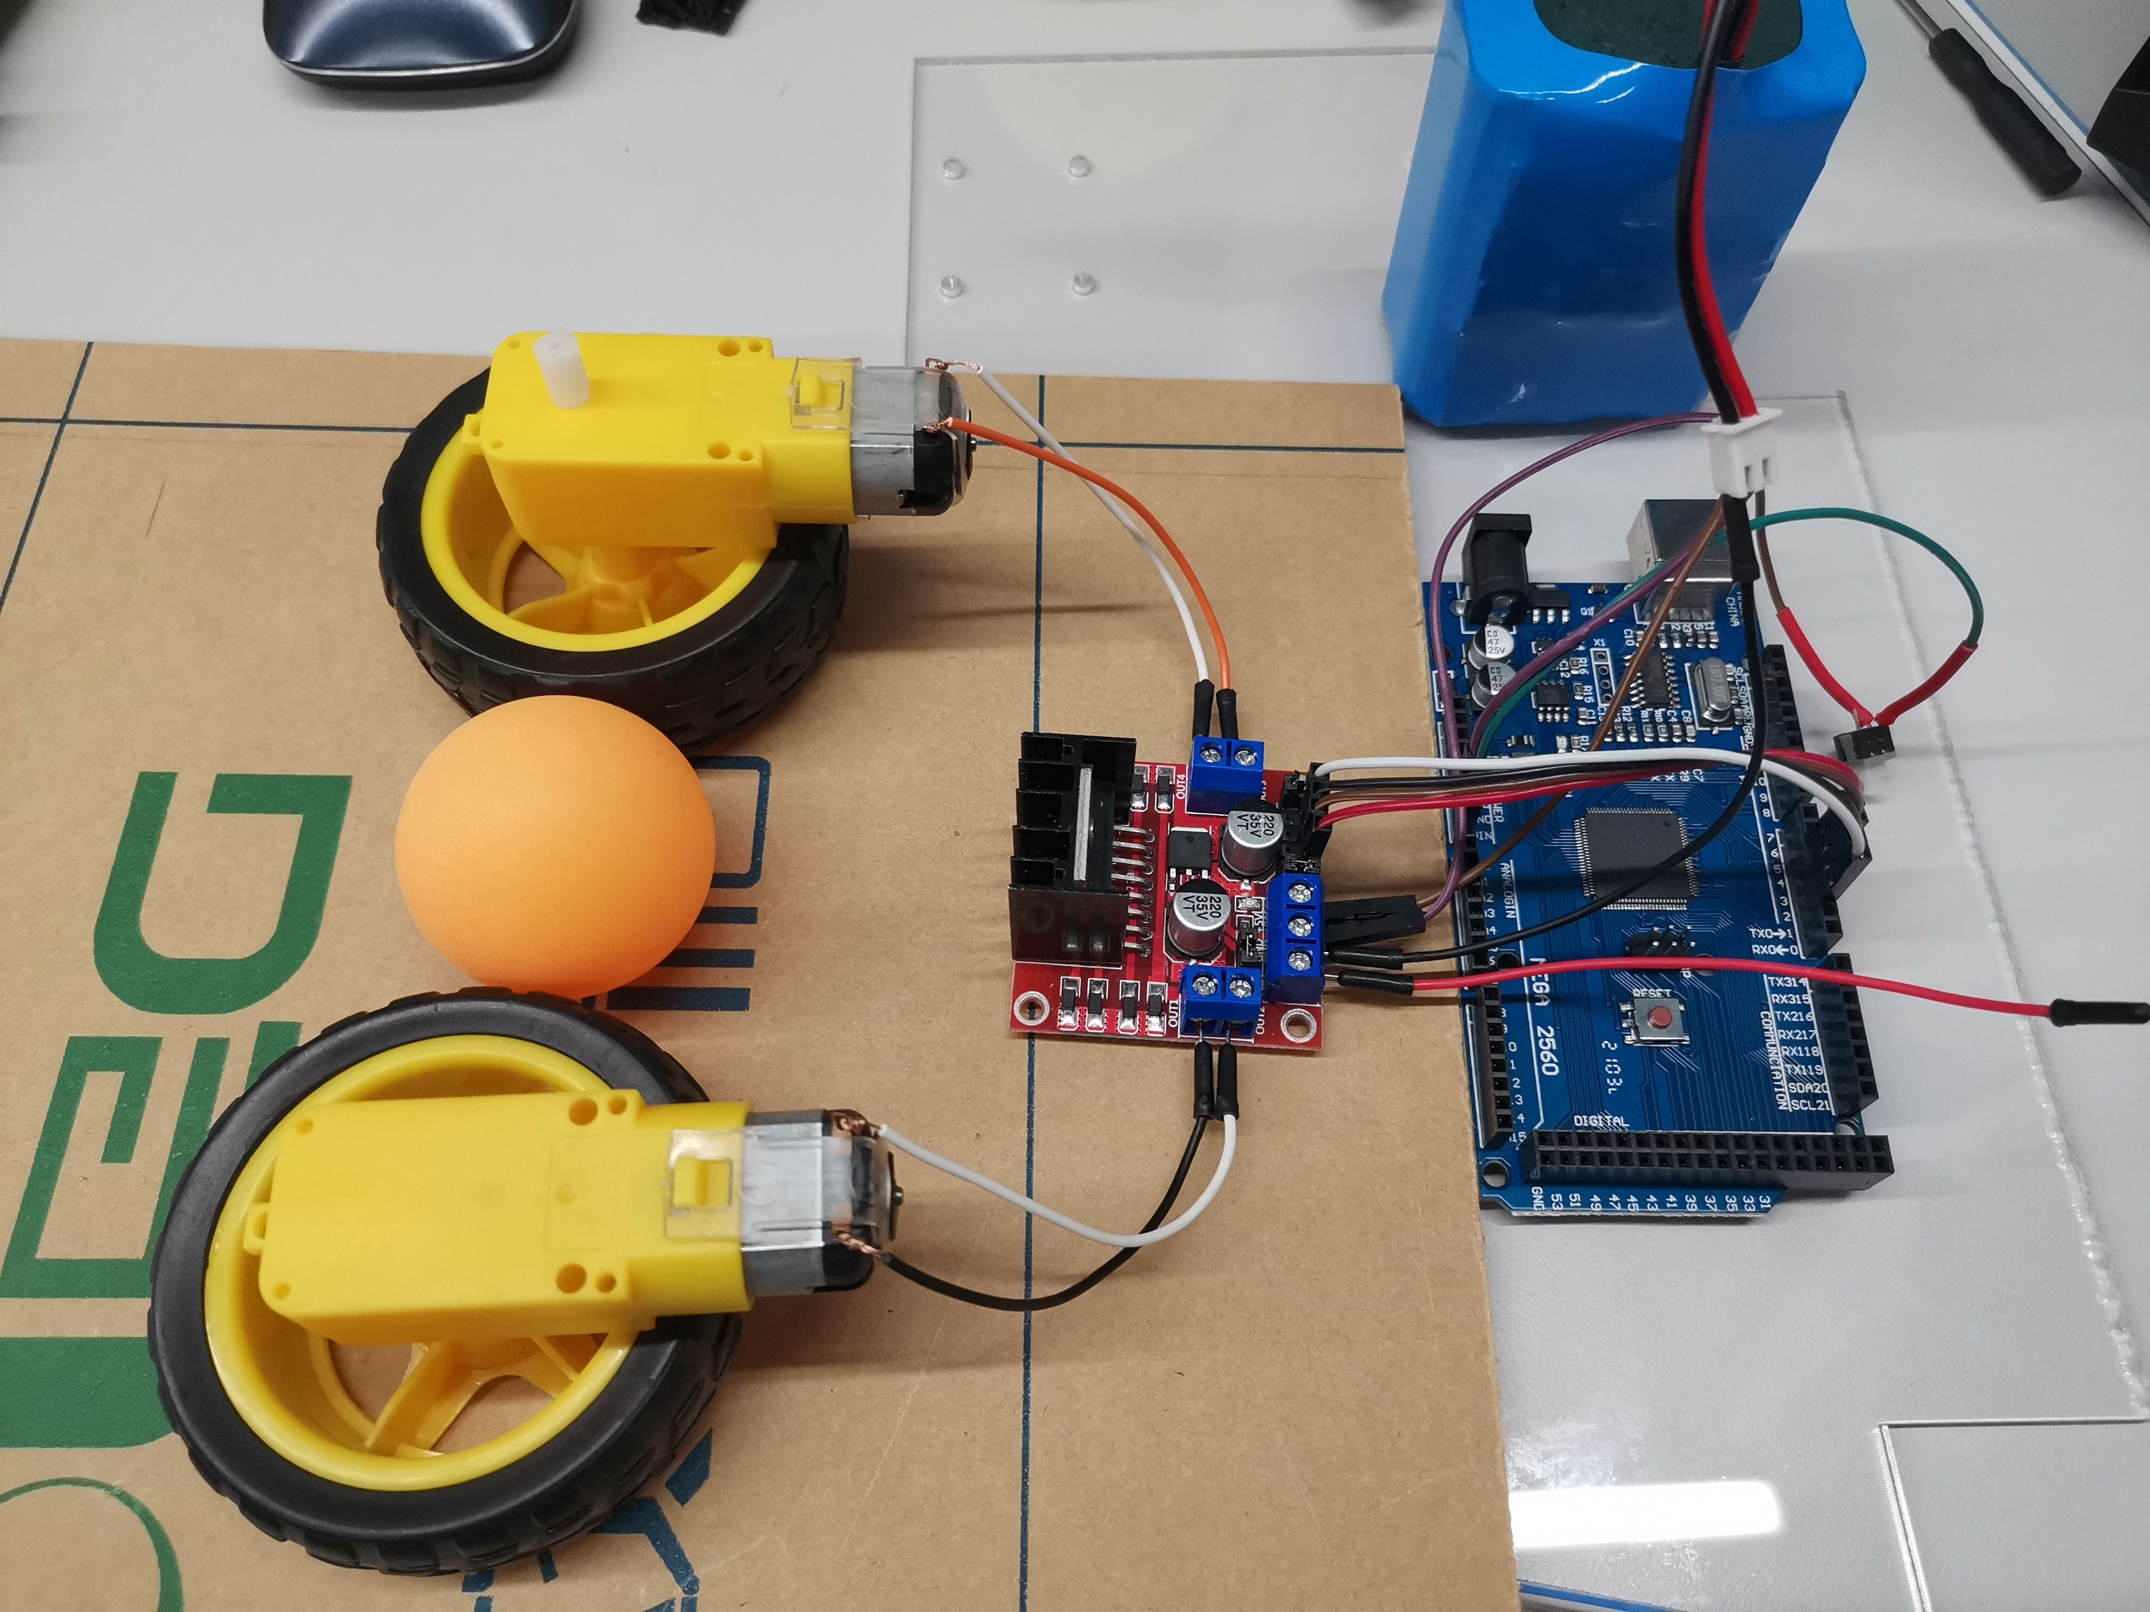
Project 1
Initial design - Catapulting Module v2
Difficulties
Reaction time is short
Friction is not enough
baffle

Slide 16
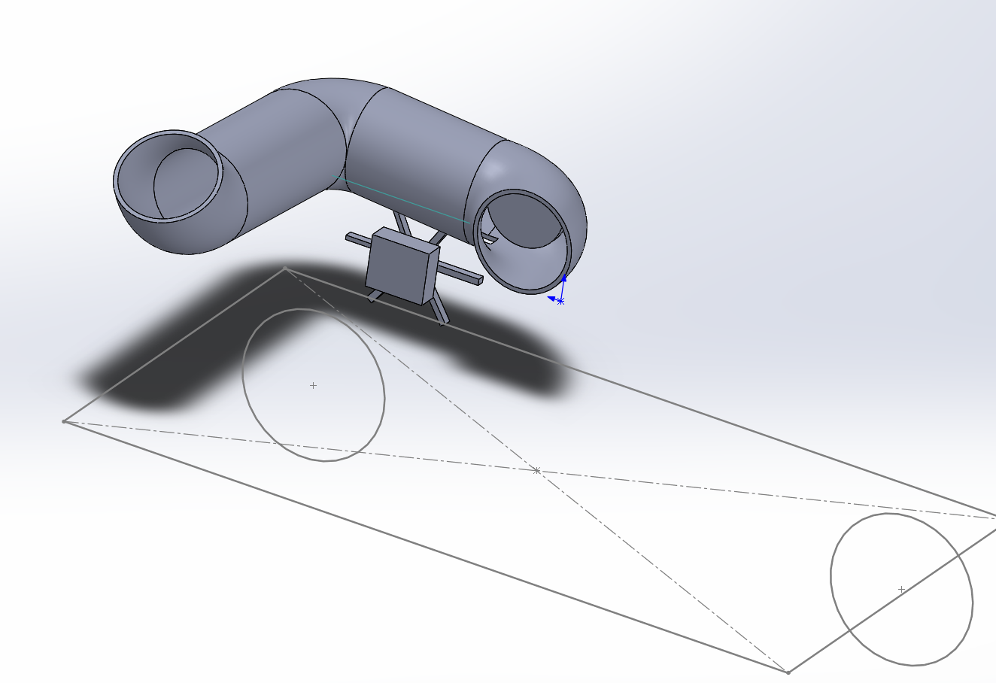
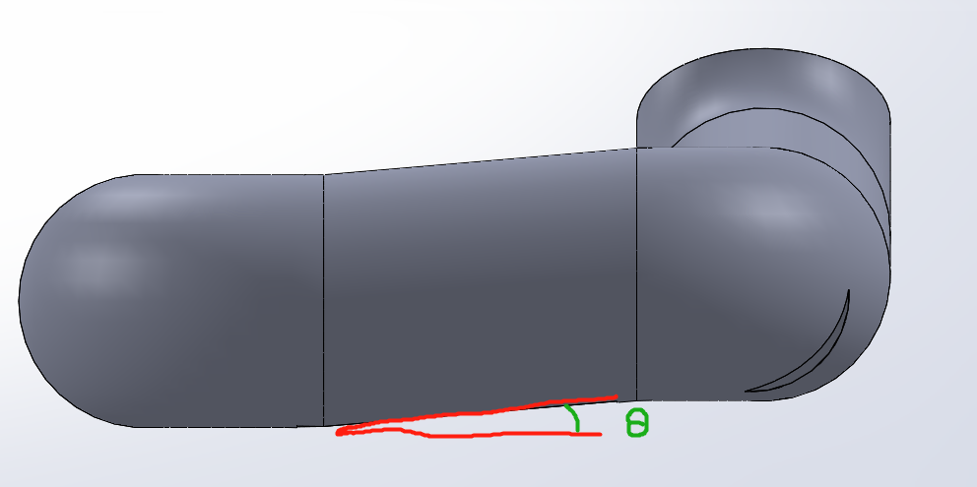
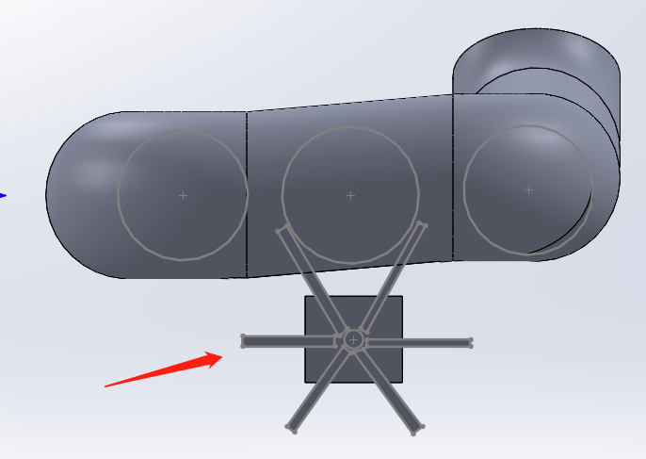
Project 1
Initial design - Ball clip
Store and transmit the ball
Low slope angle
Six blades device
Notes:
Storage device is designed to store and transmit the ping-pong ball to the launching position.
It is shaped like a curve pipe with a certain angle of incline, which keeps the ping-pong ball from falling too fast.
This turnel is long, so we can use it to store at least 5 ping-pong ball one time which really saves much time for us.
This is the motor which we use to control the ping-pong ball falling down one by one. It has six blades. The blades are placed just enough apart to hold a ping-pong ball. We do this by control the motor through bluetooth.

Slide 17
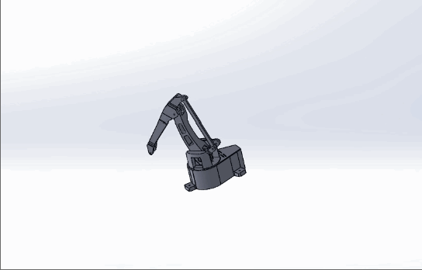
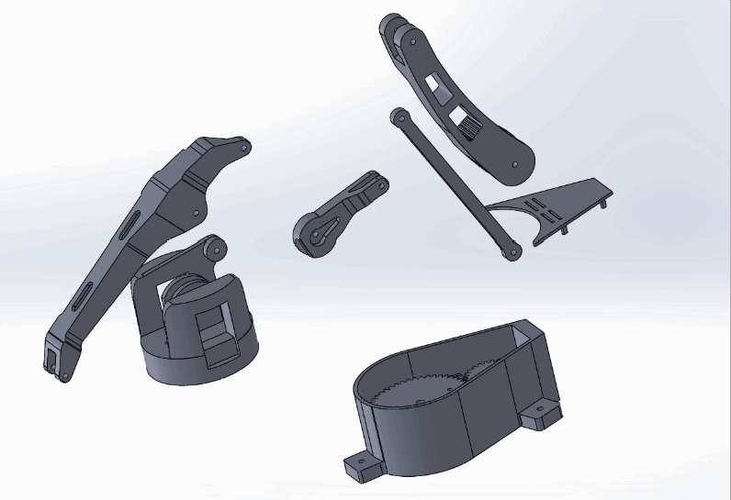

Project 1
Initial design - Robotic arm
Grab the tennis
Put it into the shooting track
Three degrees of freedom
Notes:
We set up two gears in the base plate, and the steering engine rotates the pinion to drive the bigger gear.
We try to achieve speed of the rotating the arm movement as steadily as possible.

Slide 18
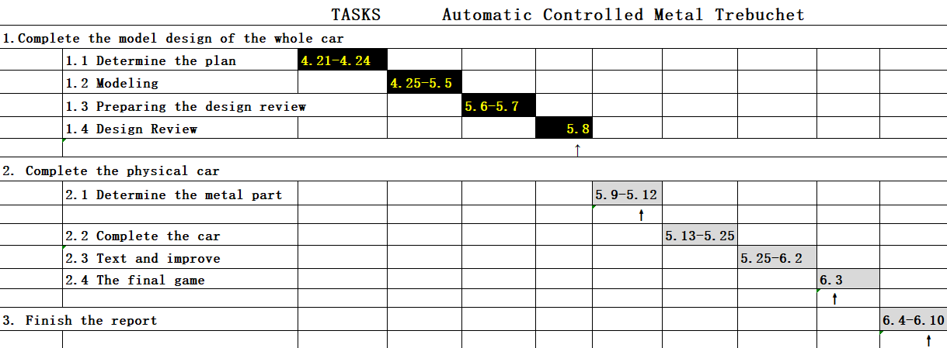
Project 1
Project Schedule
Notes:
Enter speaker notes here.

Slide 19
Project 1
Q & A
Any questions?

